Slide 1
<DATA STRUCTURES AND ALGORITHM>

Slide 2
BIG O CHEAT SHEET

Slide 3
Asymptotic Analysis
BETWEEN n² , 2^{n}, n³ WHICH ONE IS GREATER IN ASYMPTONIC ANALYSIS ?

Slide 4
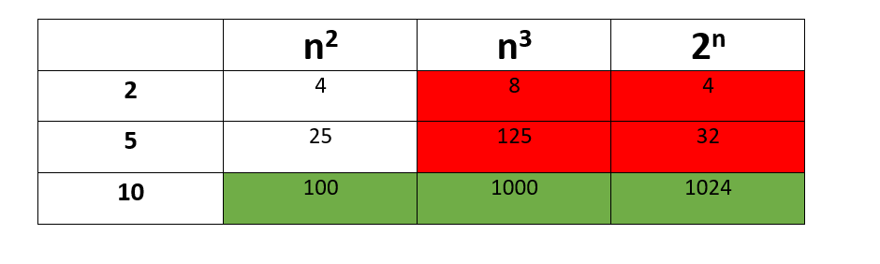
Asymptotic Analysis

Slide 5
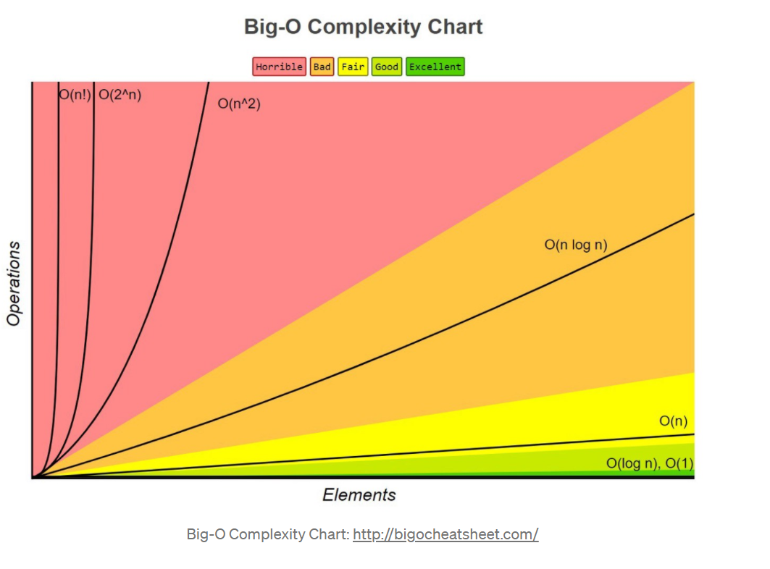
Asymptotic Analysis

Slide 6
Asymptotic Analysis
1 < logn < √n < n < nlogn < n² < n³ < … < 2^{n} < 3^{n} < … < n^{n}

Slide 7
HOW TO CALCULATE BIG O
#include <stdio.h>
int main() {
int values[5]; //1
printf("Enter 5 integers: "); //1
for(int i = 0; i < 5; ++i) {
scanf("%d", &values[i]); //n
}
return 0; //1
}
Big O = 1+1+n+1 = n + 3

Slide 8
HOW TO CALCULATE BIG O
#include <stdio.h>
int main() {
int values[5]; //1
printf("Enter 5 integers: "); //1
for(int i = 0; i < 5; ++i) {
scanf("%d", &values[i]); //n
}
printf("Displaying integers: "); //1
for(int i = 0; i < 5; ++i) {
printf("%d\n", values[i]); //n
}
return 0; //1
}
Big O = 1+1+n+1+n+1 = 2n + 4

Slide 9

HOW TO CALCULATE BIG O
#include <stdio.h>
int main() {
int i=0; //1
int j=0; //1
for(int i = 0; i < 5; ++i) {
for(j=0;j<5;j++){
printf("%d%d\n", values[i][j]); //$n^{2}$
}
}
return 0; //1
}
Big O = 1+1+$n^{2}$+1 = $n^{2}$ + 3

Slide 10
RULE 1: ALWAYS WORST CASE
int i, array[5]= {1, 2, 3, 4, 5};
for(i=0 ; i<5 ; i++){
printf("%d", array[i]) ;
}
If we are search in the loop for 1, the time complexity will be o(1);
but if we are searching for 5 in the loop, the time complexity will be 0(n), n representing the number of elements in the array. For time complexity you have always to look for the worst case.

Slide 11
RULE 1: ALWAYS WORST CASE
int i, array[5]= {1, 2, 3, 4, 5};
for(i=0 ; i<5 ; i++){
printf("%d", array[i]) ;
}
If we are search in the loop for 1, the time complexity will be o(1);
but if we are searching for 5 in the loop, the time complexity will be 0(n), n representing the number of elements in the array. For time complexity you have always to look for the worst case.

Slide 12

RULE 2: REMOVE CONSTANT
#include <stdio.h>
for(int i = 0; i < 5; ++i) {
for(j=0;j<5;j++){
printf("%d%d\n", values[i][j]); //$n^{2}$
}
}
for(int i = 0; i < 5; ++i) {
for(j=0;j<5;j++){
printf("%d%d\n", values[i][j]); //$n^{2}$
}
}
return 0; //1
}
Big O = $n^{2}+n^{2}$+1 = ${2n}^{2}$ + 1 = ?

Slide 13

RULE 3: DROP NON DOMINANT TERMS
#include <stdio.h>
int main() {
int i=0; //1
int j=0;
printf("Enter 5 integers: "); //1
for(int i = 0; i < 5; ++i) {
scanf("%d", &values[i]); //n
}
//1
for(int i = 0; i < 5; ++i) {
for(j=0;j<5;j++){
printf("%d%d\n", values[i][j]); //$n^{2}$
}
}
return 0; //1
}
Big O = 1+1+n+1+$n^{2}$+1 = $n^{2}$ + n + 4 = ?

Slide 14
BIG O CHEAT SHEET
O(1) Constant- no loops
O(log N) Logarithmic- usually searching algorithms have log n if they are sorted (Binary Search)
O(n) Linear- for loops, while loops through n items
O(n log(n)) Log Liniear- usually sorting operations
O(n^2) Quadratic- every element in a collection needs to be compared to ever other element. Two
nested loops
O(2^n) Exponential- recursive algorithms that solves a problem of size N
O(n!) Factorial- you are adding a loop for every element

Slide 15
EXERCISE
int main()
{
int i, j;
int matrix[ROW][COL] = { { 1, 2, 3 },
{ 4, 5, 6 },
{ 7, 8, 9 } };
printf("Given matrix is \n");
for (i = 0; i < ROW; i++) {
for (j = 0; j < COL; j++)
printf("%d ", matrix[i][j]);
printf("\n");
}
return 0;
}

Slide 16
QUIZ
#include <stdio.h>
int main() {
int a = 1, b = 1, c = 1;
for (i = 0; i < 100; i++) {
while(a <= 5) {
b = 1;
while(b <= 5) {
printf("%d ", b);
b++;
}
printf("\n");
a++;
}
}
while(b <= 5) {
printf("%d ", b);
b++;
}
return 0;
}

